Slide 1
Introduction to Data Science
Jonathan Berman
Sign in at http://bit.ly/2pQ8i0W

Slide 2
Overview
API Review
Explain K-means clustering
Basic cryptocurrency explanation
K-means clustering on cryptocurrency
Introduce sklearn
Introduce K Nearest Neighbors

Slide 3
API Review

Slide 4
What is an API
A set of classes and functions
These will always take in the same input and have the same output regardless of the internal workings
Allows you to use functionality without caring about how the code actually works

Slide 5
Why do we use API’s
Imagine you want to use code in multiple places.
APIs allow you to change your code more easily
You also won’t forget to change code in any place (if you copied it) which could lead to buggy or slow code

Slide 6
Some API Examples
Sorting a list repeatedly in a large program
You start with merge sort
Half way through, you realize the list is nearly ordered so insertion sort is more efficient
Instead of changing the sort method everywhere, you change your generic sort from merge to insertion
Google Maps
Let’s say you want use google maps to find the quickest way from point A to point B
They can change the actual pathfinding algorithm, but nothing in your code has to change

Slide 7
K-means Clustering

Slide 8
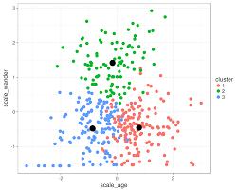
What is K-means Clustering
Takes a set of data points and separates them into K different clusters
Can be used to find data points similar to other ones
To guess the cluster of a new point off of the training data, make it the same cluster as its closest neighbor

Slide 9
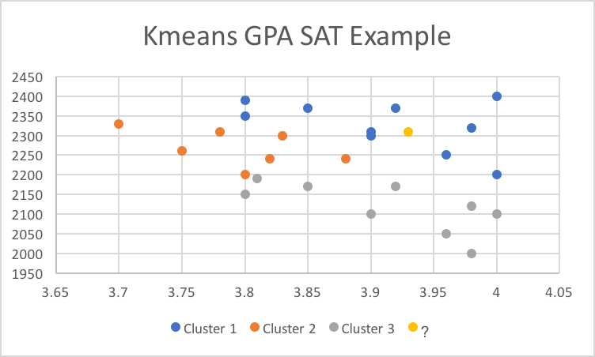
K-means Clustering Example
On the right is an example of a set of students with different GPA and SAT scores separated into 3 different clusters.
Which cluster would the unknown person be placed into?

Slide 10
K-means Clustering Example
On the right is an example of a set of students with different GPA and SAT scores separated into 3 different clusters.
Which cluster would the unknown person be placed into?
Cluster 1

Slide 11
Applying K-means Clustering to Cryptocurrency

Slide 12
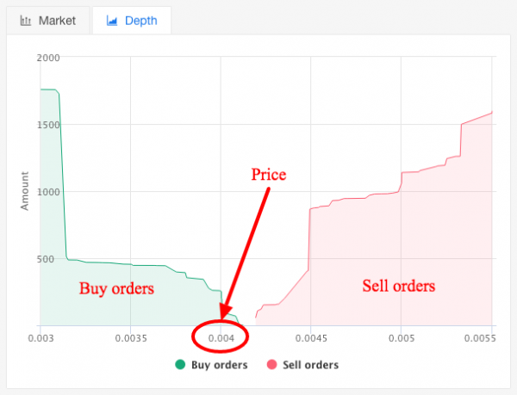
Basic Cryptocurrency
At its simplest, there are “buy” and “sell” orders, also known as “bids” and “asks”.
A buy order is someone saying I am willing to buy this cryptocurrency at this price or below.
A sell order is someone saying I am willing to sell this cryptocurrency at this price or above.
If there is someone who wants to buy at the price someone is willing to sell, a transaction will occur.
To the right is a histogram of buy and sell orders

Slide 13
How to apply K-means
We can use a lot of these graphs at different times and classify the shape.
One way to do this is to normalize the bid amounts from 0-1, and then store the values at intervals along the price. Let’s say 5 points for asks and 5 points for bids.
This way we can get quite a bit of information about the shape of the graph as a 10 dimensional data point, and then cluster a bunch of the 10 dimensional data points.
Here is some code that does that.

Slide 14
K Nearest Neighbors

Slide 15
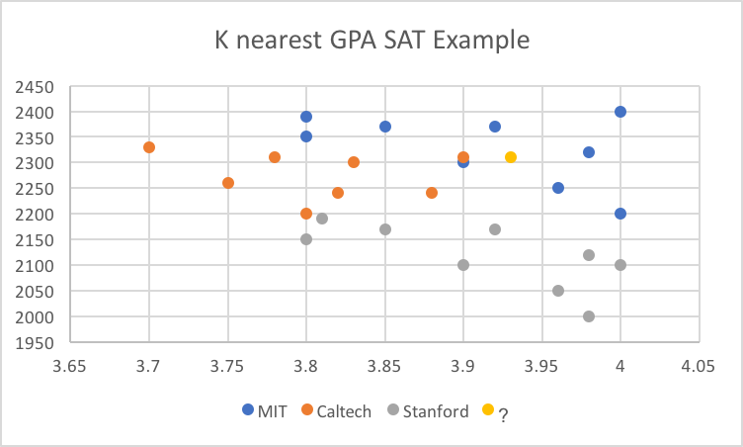
What is K nearest neighbors
How can we classify a single data point
Look at the K closest data points
The type of data point that appears the most is what we can guess the data point is
Let’s look at the unknown data point on the right
Using K=1 we get Caltech, but for K>1 we get MIT, so we would guess they go to MIT.

Slide 16
Now It’s Your Turn
Using the data on the github page about college attendance based on high-school GPA and SAT score create a K nearest neighbors classification chart. Use this to classify people with the GPAs and SAT scores found on the github page (here).
Please submit the classification image and the classification of the students in a zipped folder to Dropbox by Thursday April 5th.
An example using scikit-learn k nearest neighbors classification can be found here if you are unclear how to start. Refer to the k-means code if you are unsure how to read in and format data files. If you need help, feel free to ask Jeffrey at jdhe@college.harvard.edu and myself at jberman@college.harvard.edu

